Slide 1
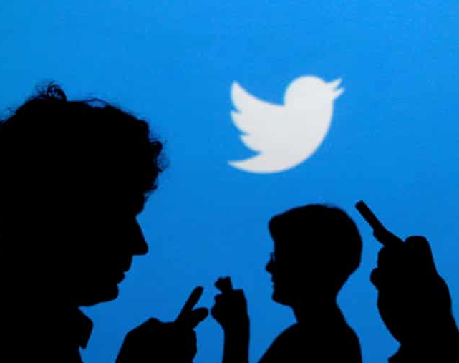
Presidential Elections 2020. Sentiment Analysis
Thomas Marianos
Gemma Miranda

Slide 2
About the Data

Slide 3
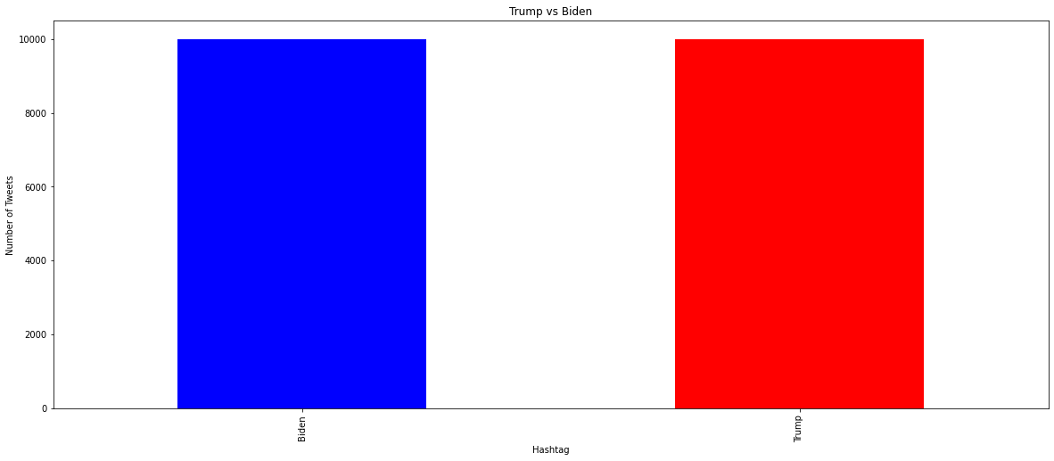
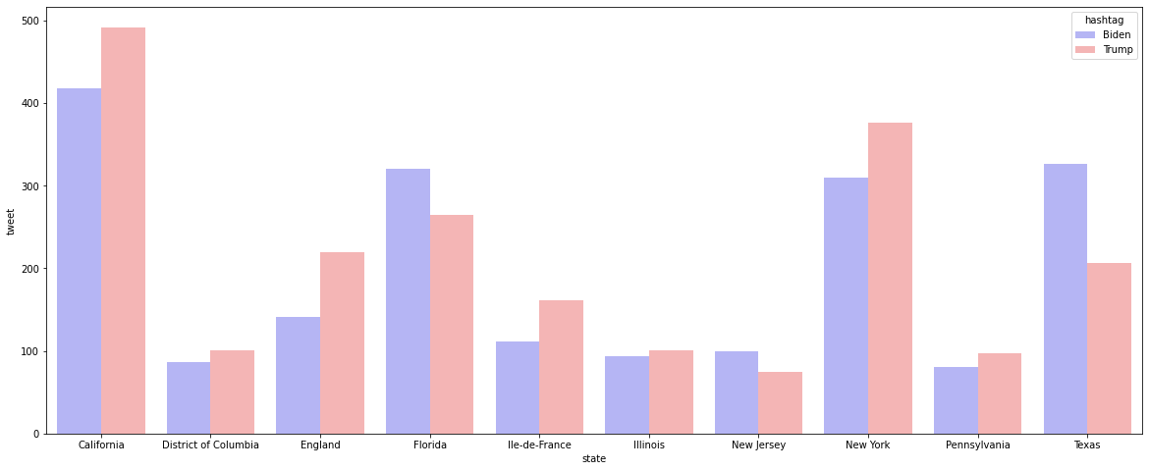
A Collection of Individuals & Tweets
6,873 Twitter handles
Two candidates
Biden and Trump
20,000 Tweets
~10,000 tweets per candidate
Average length: 84 characters; 11 words
Total vocabulary: ~42,246 words
Created: Oct-Nov-2020

Slide 4
Data Processing:
Data Collection
Data Cleaning
Stop word filter
Application: Vader
Data ready for modelling

Slide 5
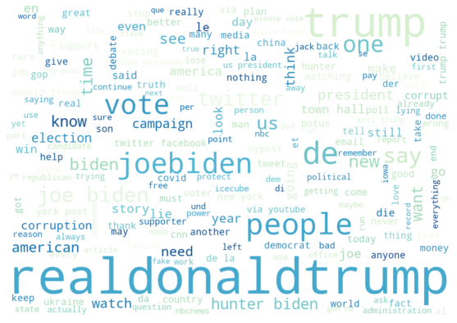
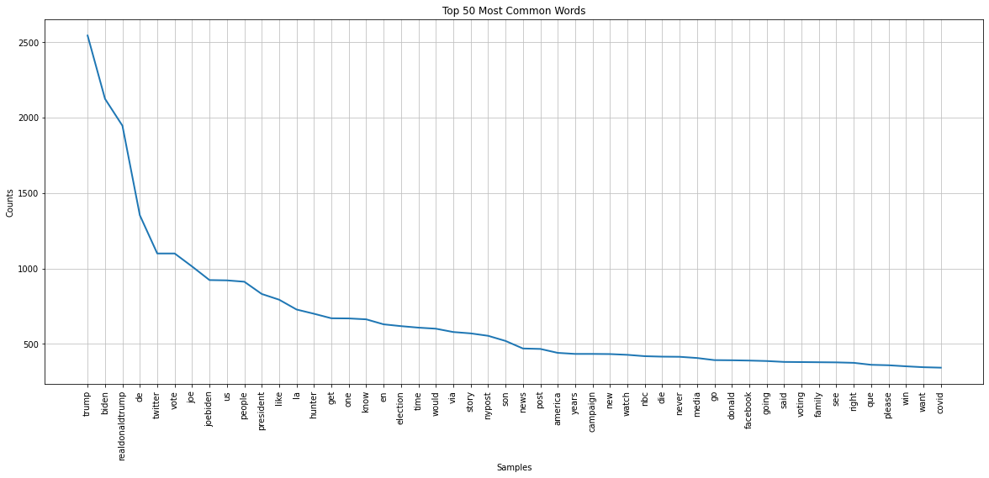
Lexicon & Sentiment Tweets are similar between groups in common terms and grammar

Slide 6
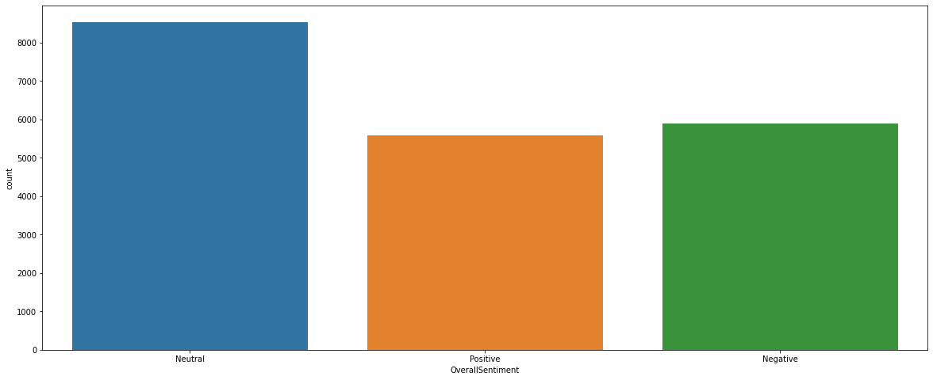
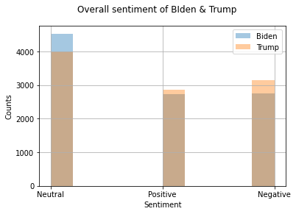
Sentiments behind the tweets showed more neutral tweets in general, but there were more neutral #JoeBiden tweets, while more positive and negative tweets included #DonaldTrump

Slide 7
Modeling the Data

Slide 8
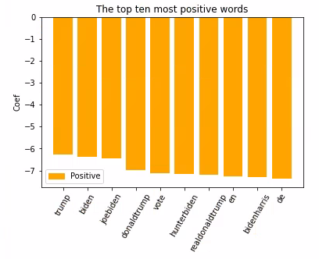
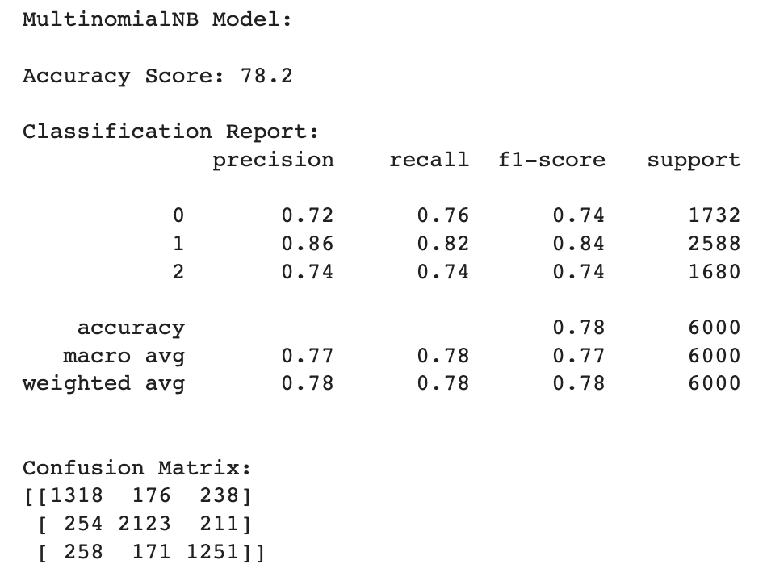
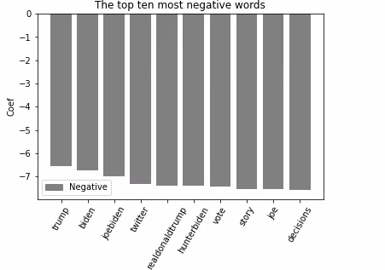
Multinomial Naïve Bayes
TTF-IDF Vectorizer, min_df = 1
Cross-10 Validation
Data into training and test at 70% and 30%, respectively.
Notes:
The data was then split into training and test sets at 70% and 30%, respectively. A multinomial Naïve Bayes (MNB) model with a Laplace of 1 was instantiated as the classifier. The model was trained and predicted on the test set with 5-fold cross validation.

Slide 9
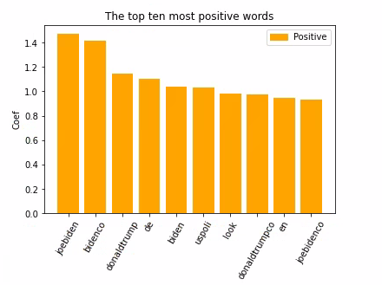
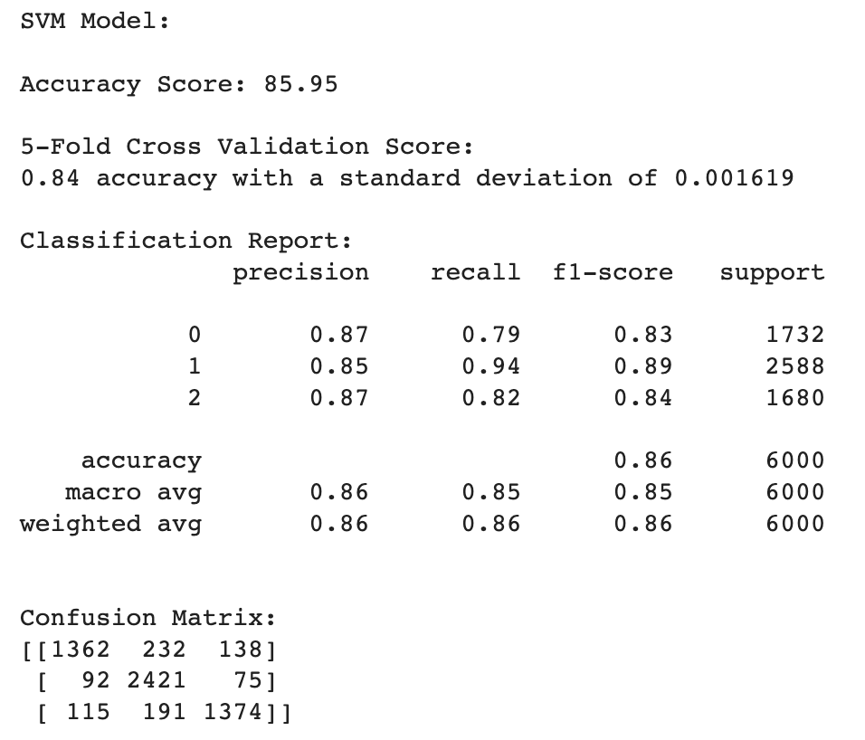
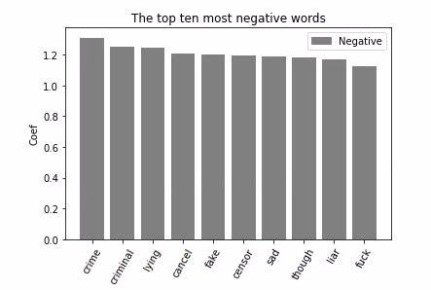
Support Vector Machines
TTF-IDF Vectorizer, min_df = 1
Cross-10 Validation
Data into training and test at 70% and 30%, respectively.

Slide 10
Conclusion

